Slide 1

MOBIDEV
{mobidev}

Slide 2
What we’ll cover:
Brief Introduction
Showcase a number of projects
Present our understanding
Discuss Possible Solution
Questions
Feedback and discuss next steps
{mobidev}

Slide 3
Introduction Who we are:
Mobidev Kenya LTD is a leading Mobile Software Development Company
Resident at M:Lab East Africa, One of the 5 labs(2 in Africa) in the world with a focus on mobile application development
4 years of design, development, testing and deployment of apps specifically for emerging markets
{mobidev}

Slide 4
Our Focus:
Our focus is on building Mobile Experiences for emerging markets:
SMS Applications – innovative services delivered via simple text messages
USSD Apps – Delivering services faster via quick processes
Smartphone Apps: - Android/Windows/iOS
{mobidev}

Slide 5

Projects: Who we’ve worked with be
Android and Web application for AfyaImara(inpatient/outpatient medical Insurance)
Service Enabled anyone to instantly get insurance quote, pay via MPESA or major card and get temporary policy number
{mobidev}

Slide 6

Who we’ve worked with before:
Complex mobile learning platform on SMS and USSD
Deployed in Kenya via 22744
Currently being deployed in TZ in partnership with Vodafone for MPAWA users
Integrated MPESA Payments, Airtime rewards
22744
{mobidev}

Slide 7

Who we’ve worked with before:
Built the USSD Application for transmission of election results in the forthcoming Nigerian Election for one of the political parties
Estimated to server ~120,000 agents
{mobidev}

Slide 8
Who we’ve worked with before:
Integration of card payments to Chandarana Supermarket.
Implemented Cybersource API
Barclays Bank of Kenya
{mobidev}

Slide 9




Other Companies:
SMS and USSD application targeting farmers.
Registration, Surveys, loyalty points, airtime rewards
{mobidev}

Slide 10
Our Understanding:
BBK intends to have a mobile lending platform for clients in the open market.
Potential clients will not need a BBK account
Users will register, get loan limit and apply for loan via ussd with notifications being sent via SMS
There will be need to integrate with CRB for loan qualification reference.
Approved loan will be disbursed through an account to be created at BBK
Direct debit with customer’s bank account to be setup
{mobidev}

Slide 11
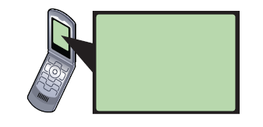
Screenshots:
*000#

Slide 12
Welcome to Barclays USSD:
1. Register

Slide 13
New user registration process:

Slide 14
Enter your Name
input
Send

Slide 15
Enter your National ID
input
Send

Slide 16
Enter your Age
input
Send

Slide 17
Enter your Company
input
Send

Slide 18
Registration successful
The platform will then send a confirmation via SMS with code from BBK

Slide 19
Welcome to Barclays USSD:
1. Check Loan limit
2. Apply for Loan

Slide 20
USSD Loan Option process – Step 1
Enter Loan amount
input
Send

Slide 21
USSD Loan Option process – Step 2
Enter BBK CODE/PIN
input
Send

Slide 22
USSD Loan Option process – Step 3
You have requested loan of:
KES 500000
Confirm by clicking send
send

Slide 23
USSD Loan Option process – End
Loan Request successful
The platform will then send a confirmation via SMS with more information

Slide 24
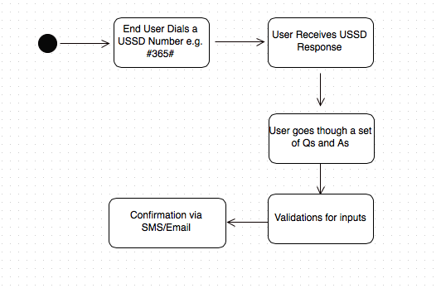
General USSD Process

Slide 25
Our approach - Methodology:
Needs assessment
Definition of options based on needs
Prototype building
Usability testing
Quality Testing
Project Management
{mobidev}

Slide 26
Questions:
Registration: Do we have IPRS link?
How to deal with users with multiple accounts
{mobidev}

Slide 27
Thank you :
Questions are welcomed
{mobidev}

